Slide 1


Sentiment Analysis for Stock Price Impact
Sentiment analysis is a powerful tool used to extract and analyze the sentiment of a text, including in stock market prediction.
by Ankita Gharate

Slide 2

Introduction
Sentiment analysis, a natural language processing (NLP) technique, is utilized to determine whether text sentiment is positive, negative, or neutral. This technique has various applications, including its impact on stock market prediction.

Slide 3
Dataset
Top Headlines
Labels
Our dataset contains curated top headlines of companies.
Each headline has a label (0 or 1) indicating a negative or positive impact on stock price.

Slide 4
Steps for Sentiment Analysis
1
Preprocessing
Clean headlines by removing stop words, punctuation, and other unwanted characters.
2
Feature Extraction
Extract features from preprocessed headlines using methods like bag-of-words, TF-IDF, or word embeddings.
3
Model Training
Train a machine learning model (e.g., SVMs, logistic regression, Naive Bayes) to predict sentiment.
4
Model Evaluation
Evaluate the model's performance on a held-out test set to identify areas for improvement.
5
Model Prediction
Use the trained model to predict sentiment and impact on stock price for new headlines.

Slide 5
Example
1
Python
2
Load Dataset
3
Feature Extraction
Use pandas, sklearn, and logistic regression to perform sentiment analysis.
Read the dataset and preprocess headlines by converting to lowercase and removing commas and periods.
Use TF-IDF vectorizer to extract features from the preprocessed headlines.
4
Model Training
5
Model Prediction
Split the dataset, train a logistic regression model, and evaluate its accuracy.
Predict sentiment and impact on stock price for a new headline.

Slide 6


Conclusion
Sentiment analysis is a powerful tool for predicting the impact of news headlines on stock prices. By following the outlined steps, you can build your own sentiment analysis model and make informed investment decisions.

Slide 7

Questions?

Slide 8
The Challenges of Sentiment Analysis
Language Variations
Sarcasm and Irony
Data Bias
Sentiment analysis must consider language nuances and context.
Understanding sarcastic or ironic statements can be challenging.
Data bias in training sets can affect sentiment analysis accuracy.

Slide 9

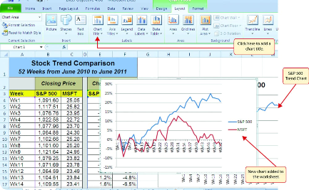
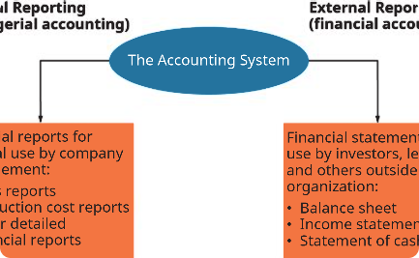
Case Studies
Stock Market Predictions
Market Trend Analysis
Investment Decisions
Real-world examples of sentiment analysis for analyzing market trends.
How sentiment analysis assists in making informed investment decisions.
Case studies highlighting successful predictions using sentiment analysis.

Slide 10
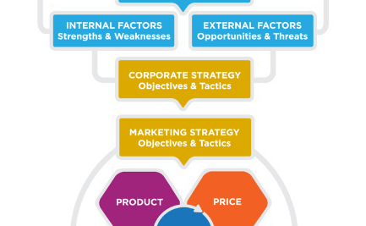


The Importance of Sentiment Analysis
Stock Market Prediction
Financial News Analysis
Consumer Sentiment
Sentiment analysis plays a crucial role in predicting stock market movements.
It helps analyze the impact of financial news on investor sentiment and market trends.
Sentiment analysis helps gauge consumer sentiment, impacting stock prices of companies.

Slide 11
Resources for Learning
1
Online Courses
2
Books
3
Research Papers
Explore online platforms like Coursera and edX for sentiment analysis courses.
Recommended books on sentiment analysis and machine learning.
Stay updated with the latest research papers and studies on sentiment analysis.

Slide 12
Thank You!
Thank you for joining us today and learning about sentiment analysis. We hope you found this presentation informative and useful. If you have any further questions or would like to explore more about sentiment analysis, feel free to reach out to us. Have a great day!

